Slide 1
12.02.2018
Big Map Tyrone
Team Big Man Tyrone - Aleksi, Leo and Joakim

Slide 2
Presentation outline
Project goals
Milestones
Division of work
Methods and tools used
Problems and solutions
Outcome
Lessons learned
References
Questions and answers

Slide 3
Project goals and theme
Creation of an Android application based on Thingsee as a GPS tracker
Use a map in order to present a clear, understandable overview
Show total travel distance between Global Positioning System (GPS) coordinates
Make a graphical user interface (GUI) that is easy to use
Confirm usability of app

Slide 4
Milestones
06.02.2018 - Base code infrastructure
28.02.2018 - Calculation formulas complete
05.03.2018 - GUI and usability optimization
08.03.2018 - Project finalization
Notes:
edit example dates to match actual dates

Slide 5
Division of work
Aleksi: Coding, mathematical formulas, Google Maps application programming interface (API) implementation
Leo: Coding, mathematical formulas, time calculations
Joakim: Coding, implementation tips, velocity calculations, app icon

Slide 6
Methods and tools used
Android Studio - As development platform
Oracle Java - As language to be used in development
Thingsee One - As the tool the app is based on
Google Maps - As the tool used for map GUI

Slide 7
Problems and solutions
Map lines did not end and begin at markers
Markers at 0,0 coordinates
Mathematics gave wrong result
Had to click button twice to get data and map
Take points from array
Prevent 0,0 coordinate values from drawing on the map
Replace radians with degrees
Turn one button into two

Slide 8
Outcome
Project success
All objectives met
All planned features implemented
All projected use-scenario requirements fulfilled
Notes:
leo

Slide 9
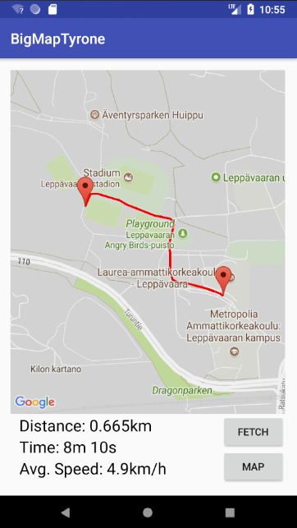
Example of app operation
Information at bottom
Map as center emphasis
User controls made intuitive
Notes:
leo

Slide 10
Lessons learned
Thingsee? more like Sometimes-see!
Thingsee authentication procedure
Importance of debugging
Android app development
Notes:
leo

Slide 11
References
Calculating the difference between two Java date instances. (2009, October 12). Retrieved March 8, 2018 from https://stackoverflow.com/questions/1555262/calculating-the-difference-between-two-java-date-instances
Adding a Map with a Marker. (2007, June 7). Retrieved March 5, 2018 from https://developers.google.com/maps/documentation/android-api/map-with-marker

Slide 12
Questions and Answers

